Slide 1
Geo
A geometric solution language
Qi Wang, Yuechen Zhao
Zichen Chao, Ziyi Luo

Slide 2
Motivation
Geometry is useful in mathematics, physics, computer science and so many fields.
But built-in support for graphs are not provided in most programming languages.
Geo is here to help!
A simple while powerful language for graph creation and manipulation.
The best part about Geo - dynamic graphs.

Slide 3
Language Tutorial
A basic sample
No entry function
function gcd(a:int, b:int): int:
while(a != b):
if(a>b):
a = a - b;
else:
b = b - a;
end
end
return a;
end
control structures: if-else, while, for
data types: int, float, bool, char, string
keyword end defines the scope

Slide 4
Language Tutorial
Something special
Geometric types: line, dot, polygon, circle
model dot(x:float, y:float);
model line(dot1:dot,dot2:dot);
model polygons: polygons(num_of_apex:int,apex[]:dot);
model circle: circle(center:dot,radius:float);
Presets:
@panel panelname (essential) - defines a panel
@mode workingmode (optional) – console/figure
@co cosystem (optional) - coordinate system, cartesian/polar
@end (essential) - the boundary of a specific panel
Dynamics:
model runset: runset(times_of_run:int, g1:geometric_shape, run_para_g1:char, ...);
function setRunstep(val:float,pos:char):void;

Slide 5
Language Tutorial
Advanced stuff
//panel presets
@panel panel_demo
@mode figure
//geometric shape declaration and initialization
line1 = line(2.0,3.0);
circle1 = circle([3,4], 5);
//runset declaration and initialization
line1.setRunstep(-0.5,'a');
circle1.setRunstep(0.1,'b');
rs = runset(50, line1, 'a', circle1, 'b');
//run statement description
run rs:
set = line1.intersect(circle1);
if (!set.empty())
print_dot_list(set);
end
@end
mode that the program will be executed in
geometric types: dot, line, circle and polygons
geometric control type - runset
keyword run -dynamic analysis
print intersection points

Slide 6
Language Tutorial
Add the graph example of last slide here
???

Slide 7
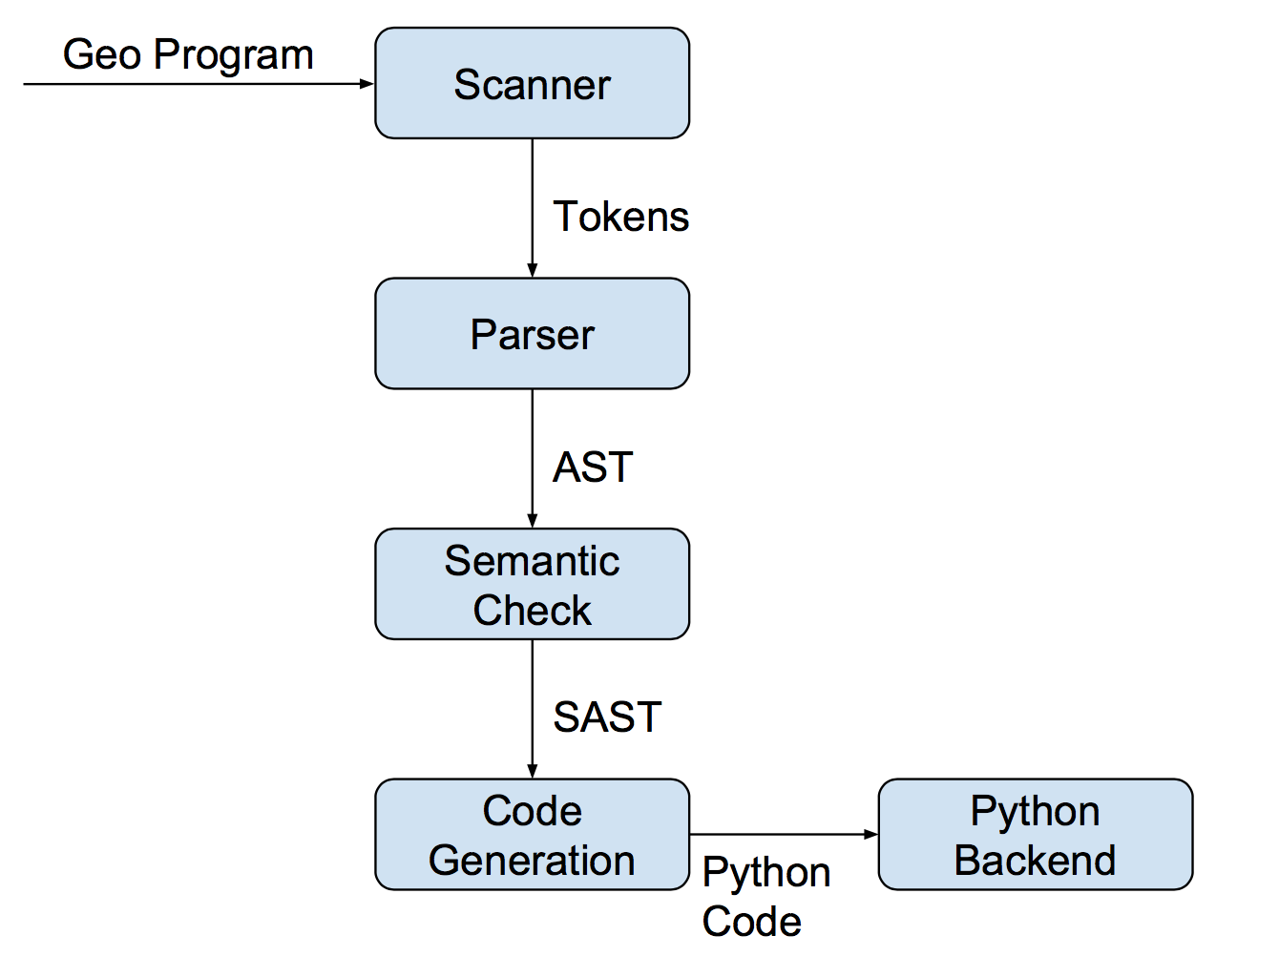
Architecture

Slide 8
Architecture
Source code statistics
File | Lines | Role
scanner.mll | 95 | Breaks input stream into tokens
parser.mly | 135 | Parses tokens into an AST
ast.ml | 50 | Defines acceptable AST structure
pyast.ml | 38 | Defines acceptable python AST structure
compile_sc_py.ml | 377 | Translates geo AST to python AST
compile_to_pycode.ml | 78 | Generates python code
geo_sc_py.ml | 13 | Top level

Slide 9
Semantic Check
Semantic Check
Use StringMap to implement translation environments
vars: keep information about variables
funcs: keep information about functions
func_opt: keep information about types of function parameters
Check for:
undeclared variables and functions
mismatched types
wrong types
function parameters not match
undefined operations
Geo syntax error
…..

Slide 10
Code Generation
Algorithm Example
@panel qsort
function qsort(a:list, l:int, r:int):list:
i = l;j = r; mid = (l+r)/2;
while (i <= j):
while (i <= j & a#[i] < a#[mid]):
i = i+1;
end
while (i <= j & a#[j]> a#[mid]):
j = j-1;
end
if (i <= j):
k = a#[i];a#[i] = a#[j]; a#[j] = k; i = i+1;j = j-1;
end
end
if (l < j):
a = qsort(a, l, j);
end
if (i < r):
a = qsort(a, i, r);
end
return(a);
end
b = {3,7,8,32,1,4,7,9,2,5}; b = qsort(b, 0, len(b)-1); print(b);
@end

Slide 11
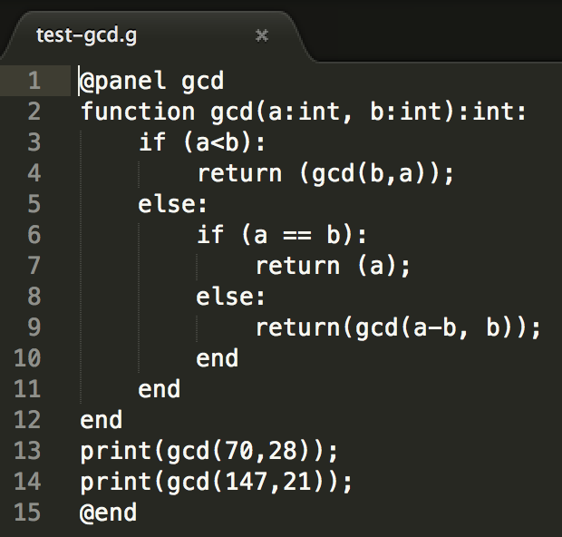
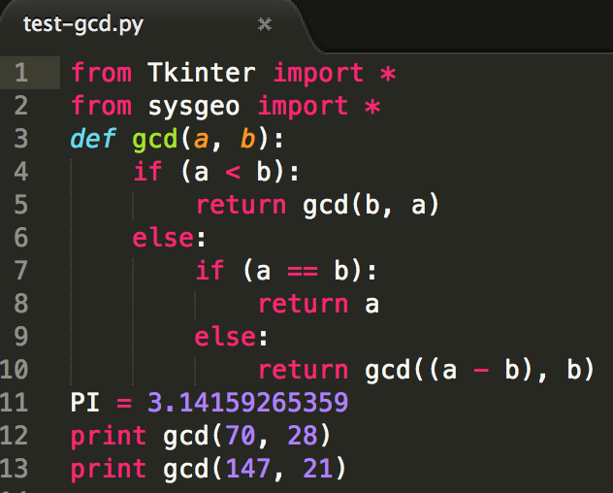
Code Generation
Algorithm Example (demo_fb.g)

Slide 12
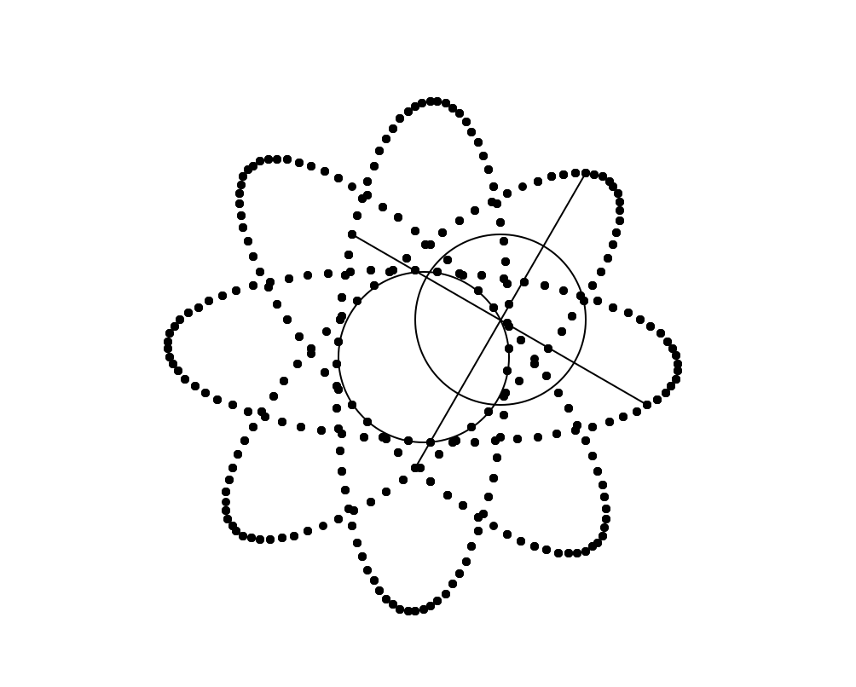
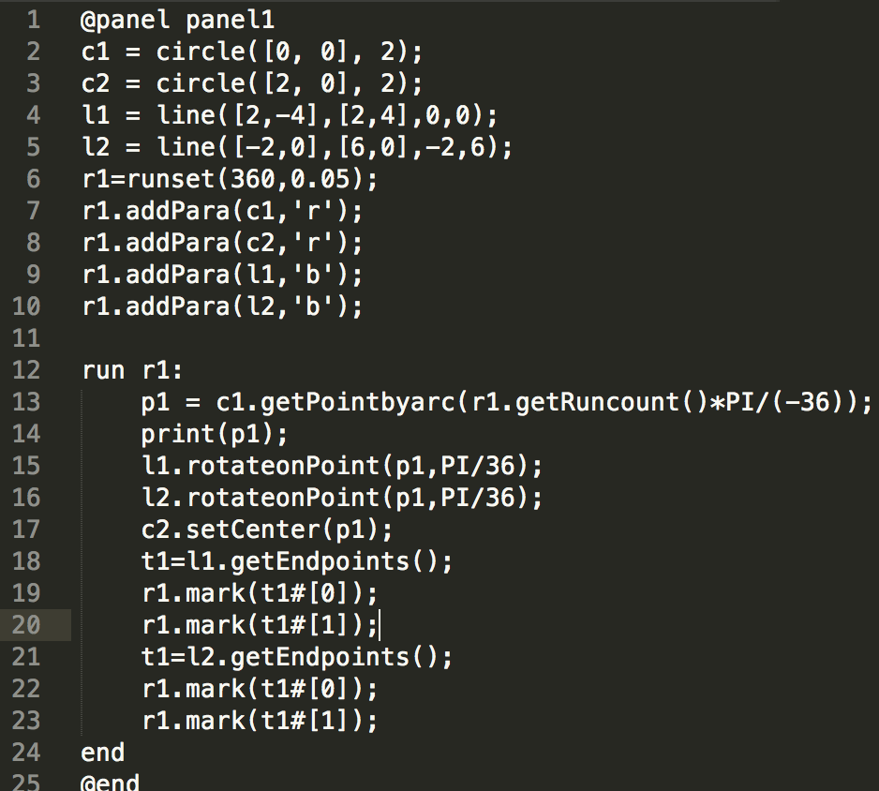
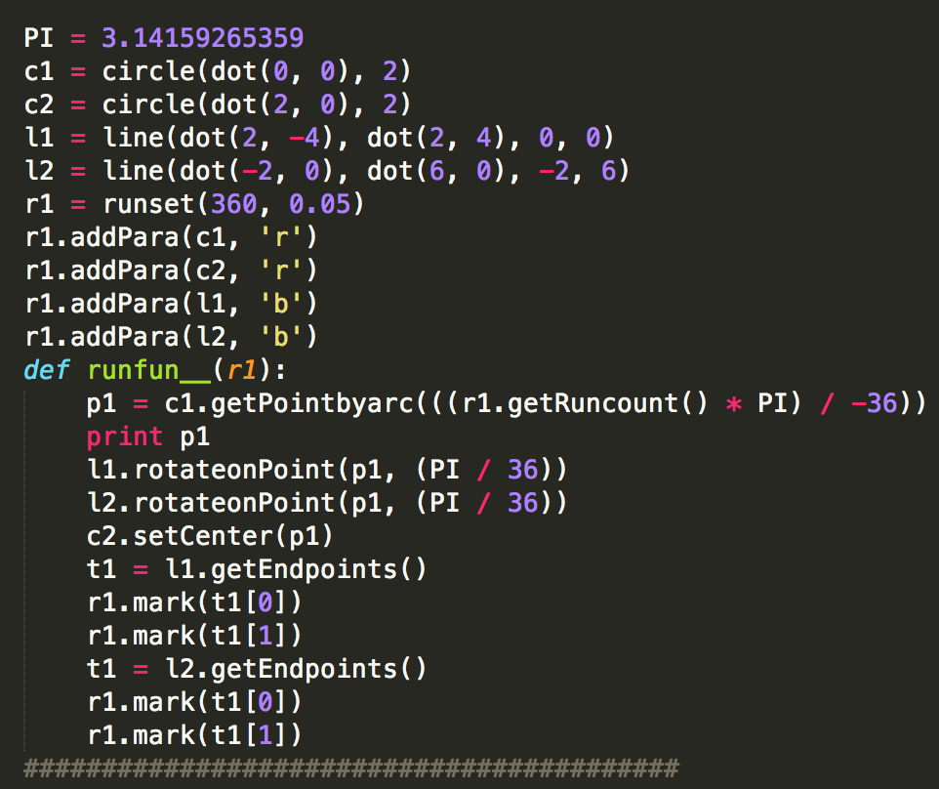
Code Generation
Graph Example

Slide 13
Testing
Test case statistics – comprehensive check
File | Lines | File | Lines | Role
test-assignments.g | 14 | test-assignments.ref | 6 | All kinds of assignments
test-circle.g | 19 | test-circle.ref | 12 | Geo type circle & obj funcs
test-comparison.g | 11 | test-comparison.ref | 6 | Comparison & boolean opts
test-dot.g | 7 | test-dot.ref | 3 | Geo type dot & obj funcs
test-fib.g | 18 | test-fib.ref | 9 | Recursive function
test-for.g | 5 | test-for.ref | 10 | For statements
test-function.g | 37 | test-function.ref | 1 | Function & if & while
test-gcd.g | 15 | test-gcd.ref | 2 | Function & if statement
test-if.g | 11 | test-if.ref | 1 | If statements (nested)
test-line.g | 35 | test-line.ref | 15 | Geo type line & obj funcs
test-list.g | 8 | test-list.ref | 4 | List
test-operations.g | 20 | test-operations.ref | 9 | Check +-*/^% opertations
test-polygon.g | 20 | test-polygon.ref | 11 | Geo type polygon & obj funcs
test-print.g | 10 | test-print.ref | 8 | Print function
test-qsort.g | 35 | test-qsort.ref | 1 | List & recursive function
test-while.g | 7 | test-while.ref | 6 | While statement

Slide 14
Testing
Test case statistics – error check
File Name | Lines | Role
error-semantics1.g | 2 | Undeclared funtion
error-semantics2.g | 5 | Funtion input para type error
error-semantics3.g | 6 | Undefined argument
error-semantics4.g | 3 | Char cannot plus int/float
error-syntax1.g | 1 | Lose end
error-syntax2.g | 1 | Unrecognized token
error-syntax3.g | 1 | Lose semicolon
error-syntax4.g | 2 | Wrong function declaration
error-syntax4.g | 1 | If statement error

Slide 15
Testing
Auto check – geotestall.sh
First: Check whether all files can be successfully compiled;
Then: Compared the output with the ref answer.

Slide 16
Lessons Learned
Qi Wang:
“Start early on the project and make a plan ahead, if things are different from scheduled, discuss together and activate soon.”
Yuechen Zhao:
“Effective communications are the key to success, do not waste too much time on arguing plans, but discussion is important.”
Zichen Chao:
“Keep the whole picture in mind, modify the plan as the project progressed and learn Ocaml as early as possible!”
Ziyi Luo:
“Comprehensive test cases are important and test early, you can never imagine how many problems you may encounter when testing.”

